Slide 1


DATA AUGMENTATION
FOR
IMAGE CLASSIFICATION
USING GAN
PRESENTED BY :
R.Vishnuraj
Reg No:613521104313
Government college of engineering, Dharmapuri.

Slide 2


AGENDA
Problem Statement
Proposed Solution/System
Who are the end users
The WOW in my solution
System Development Approach
Algorithm & Deployment
Result
Conclusion
Reference

Slide 3
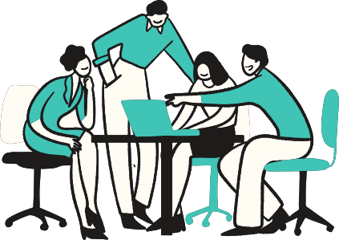
PROBLEM STATEMENT
Generating diverse and labeled datasets for image
classification with generative AI can be difficult and expensive. Current data augmentation methods might not fully capture complex variations, resulting in limited model performance. We need better techniques that fit generative AI, preserving important information and seamlessly working with existing models. These improvements will make models stronger, boost image classification accuracy, and open doors for new applications.

Slide 4
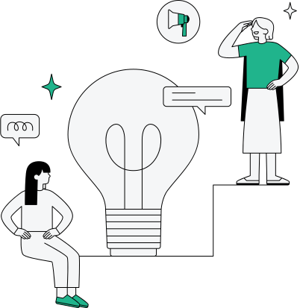
PROPOSED SOLUTION
A Generative Adversarial Network (GAN) is a type of artificial intelligence framework proposed by Ian Goodfellow and his colleagues in 2014.
It consists of two neural networks, the generator and the discriminator, which are trained simultaneously through an adversarial process.

Slide 5
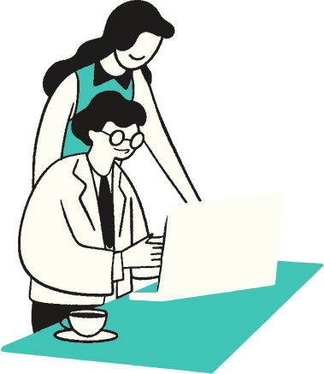
PROPOSED SOLUTION (Contd.)
Generator Network:
Utilizes convolutional layers for feature extraction.
Employs activation functions like ReLU for non-linearity.
Output layer uses Tanh activation to generate realistic images.
Discriminator Network:
Employs convolutional layers for feature extraction.
Utilizes batch normalization for stabilizing training.
Output layer uses Sigmoid activation for binary classification (real or fake).

Slide 6

WHO ARE THE END USERS
Researchers and Academia: Researchers in the fields of computer vision, deep learning, and artificial intelligence may use the techniques developed in this project to advance the state-of-the-art in image classification and data augmentation. Academia may also benefit from the educational resources and insights produced by the project.
Industry Professionals: Professionals working in industries such as healthcare, finance, retail, and manufacturing may leverage the improved image classification models for various applications, including medical image analysis, fraud detection, object recognition, and quality control.
Data Scientists and Machine Learning Engineers: Data scientists and machine learning engineers may integrate the developed models and techniques into their workflows to improve the performance of image classification systems in production environments. They may also use the project as a reference for developing their own data augmentation pipelines using GANs.

Slide 7

THE WOW IN MY SOLUTION
The "wow" factor in a project on data augmentation for image classification using Generative Adversarial Networks (GANs) lies in its ability to significantly enhance the performance and robustness of image classification models. By leveraging GANs to generate realistic synthetic images, coupled with traditional augmentation techniques, the project can create a more diverse and comprehensive training dataset. This augmented dataset enables the classification model to learn richer representations of the underlying data distribution, leading to improved accuracy and generalization capabilities.

Slide 8

SYSTEM APPROACH
Deep Learning Framework: Libraries such as TensorFlow, PyTorch, or Keras for implementing data augmentation techniques and training models.
Image Processing Libraries: Packages like OpenCV or Pillow for image manipulation and augmentation.
Python Environment: A Python interpreter along with necessary dependencies for running the code.
Variety of Techniques: Implement a diverse set of augmentation methods such as rotation, translation, scaling, flipping, cropping, adding noise, etc.
Customization Options: Ability to adjust augmentation parameters (e.g., rotation angle, scaling factor) based on specific requirements and dataset characteristics
Training Environment: A suitable environment for training deep learning models, including access to necessary computing resources and frameworks.
Data Pipelines: Efficient data loading and preprocessing pipelines to handle augmented data during model training.

Slide 9

ALGORITHM & DEPLOYMENT
To employ Generative Adversarial Networks (GANs) for data augmentation with the MNIST dataset, the algorithm starts with data preparation, including loading and normalization of the dataset. Subsequently, GAN training commences, involving the design and training of both the generator and discriminator networks to produce realistic synthetic images resembling handwritten digits.
GAN Training:
Design and initialize generator and discriminator networks. Train discriminator on real MNIST images and fake images generated by the generator. Train generator to produce images that can fool the discriminator. Iterate until convergence or predefined number of epochs.
Data Augmentation:
Use trained generator to generate synthetic images. Apply traditional augmentation techniques to real MNIST images and generated images. Combine original MNIST dataset with augmented dataset

Slide 10
ALGORITHM & DEPLOYMENT (Contd.)
Model Deployment:
Deploy trained classification model for inference. Integrate the model into production systems or applications. Provide necessary APIs for model integration and usage.
For deployment, the trained classification model is deployed into production environments, leveraging GPU-accelerated hardware for efficient inference. The model's functionality is exposed through APIs for seamless integration with other systems or applications. Continuous monitoring and maintenance ensure optimal performance, with periodic updates and retraining to adapt to evolving data distributions and maintain accuracy. Overall, this approach enhances the classification model's accuracy by leveraging GANs for data augmentation, improving its performance in real-world image classification tasks.

Slide 11
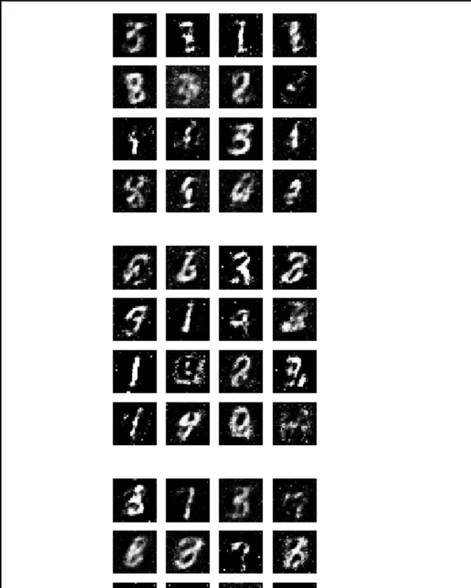
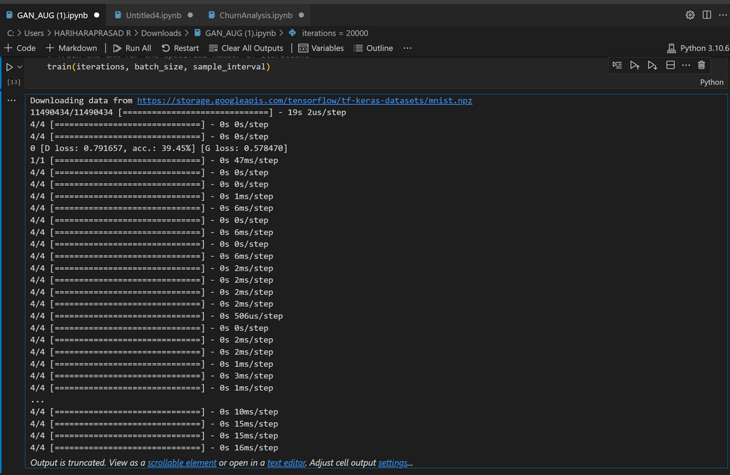
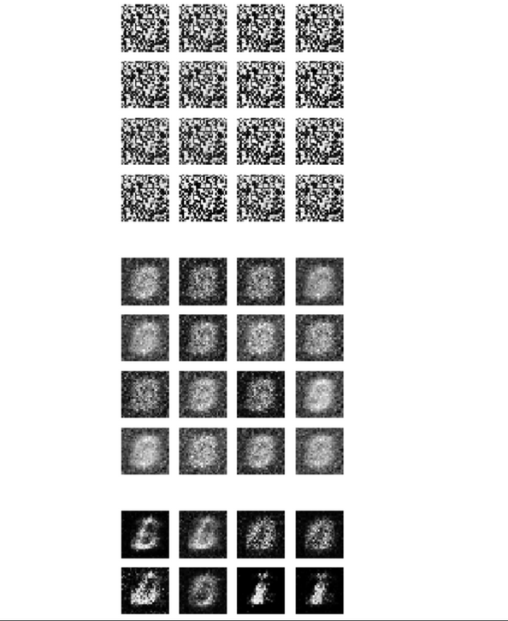
RESULT

Slide 12
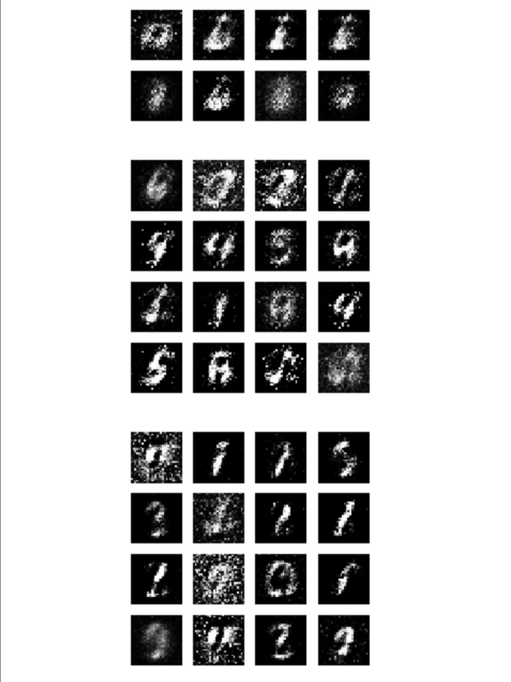
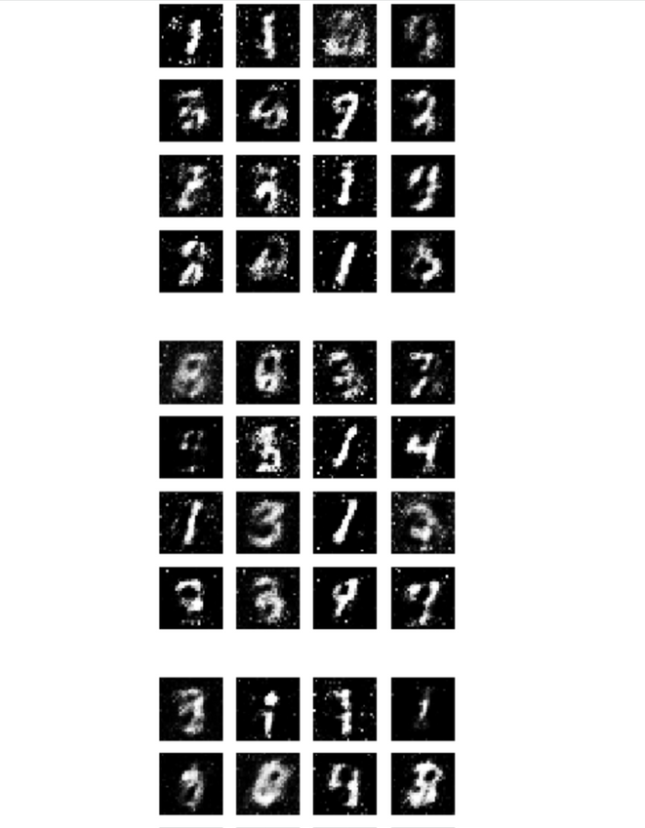
RESULT

Slide 13

CONCLUSION
In conclusion, the implementation of data augmentation for image classification using Generative Adversarial Networks (GANs) offers a powerful solution to enhance the performance and robustness of classification models. By leveraging GANs to generate realistic synthetic images, coupled with traditional augmentation techniques, we can significantly expand the diversity and size of the training dataset. This augmentation process equips the classification model with a more comprehensive understanding of the underlying data distribution, leading to improved accuracy and generalization capabilities. Furthermore, the deployment of such augmented models into production environments facilitates better real-world performance, enabling more accurate classification of images in various applications and domains. As we continue to refine and innovate in the realm of data augmentation with GANs, we unlock new possibilities for advancing image classification technology and addressing complex challenges across industries. Through diligent implementation and ongoing refinement, data augmentation using GANs stands poised to remain a cornerstone technique for enhancing the efficacy of image classification systems in the future.

Slide 14

REFERENCE
Shorten, C., & Khoshgoftaar, T. M. (2019). A survey on image data augmentation for deep learning. Journal of Big Data
TensorFlow Documentation: https://www.tensorflow.org/
PyTorch Documentation: https://pytorch.org/docs/stable/index.html
MNIST Database: http://yann.lecun.com/exdb/mnist/
Unsupervised Representation learning : https://arxiv.org/abs/1511.06434

